Slide 1
Predicting Crime Categories For SF City and SF Districts
Vishweshkumar Patel - 012461371
Dennis Simon - 007742215
Varun Shah - 010823657

Slide 2
Introduction to Problem and Objective
The project focuses to use past records of crime incidents in San Francisco to predict(classify) danger of specific type of crime occurrence at specific location of the district for certain day of week and time.
The outcome of the project is to predict(classify) potential dangers/crimes (e.g. assault, battery, theft, drug use, etc.) for a respective district.
The use-case provides more insights to police departments to make certain decisions to improve public safety for a respective district.
Test three different methods for supervised classification: XGBoost, Multilayer Perceptron (Neural Network based), Ensemble
Compare global city level model with 10 district level model

Slide 3
Dataset
Attribute | Type | Attribute Description
IncidntNum | Number | Incident number reported for a crime
Category | Text | Category of a crime
Descript | Text | A brief description of crime incident
DayOfWeek | Text | Day, when crime happened
Date | Date | Date, when crime happened
Time | Time | Time, in between “00:00” to “23:59”
PdDistrict | Text | Police Department District
Resolution | Text | Police action(s) for respective crime
Address | Text | Apt and Street address where crime happened
X | Number | Longitude
Y | Number | Latitude
Location | Location | Location
Pdid | Number | Unique Identifier for use in update and insert operations
Dataset from ‘DataSF’ for Police Department Incidents
https://data.sfgov.org/Public-Safety/-Change-Notice-Police-Department-Incidents/tmnf-yvry
2,206,399 total rows/incidents as of 5/1
13 features

Slide 4
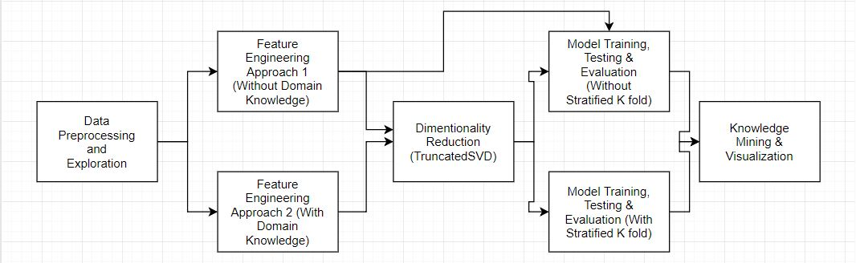
MLP Classifier Methodology/Architecture
Architecture
Two approaches:
Approach 1 - Without considering domain knowledge ~20% accuracy
Approach 2 - Considering external domain knowledge to generalize categories (Index-More Serious, Non Index- Less Serious) and perform hotspot analysis ~68% accuracy with focused crime locations, more efficient to optimize resource allocation

Slide 5
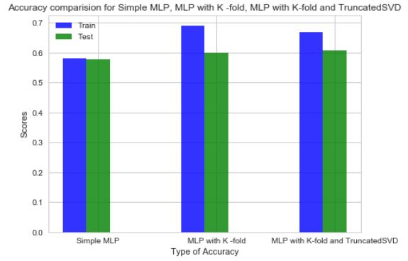
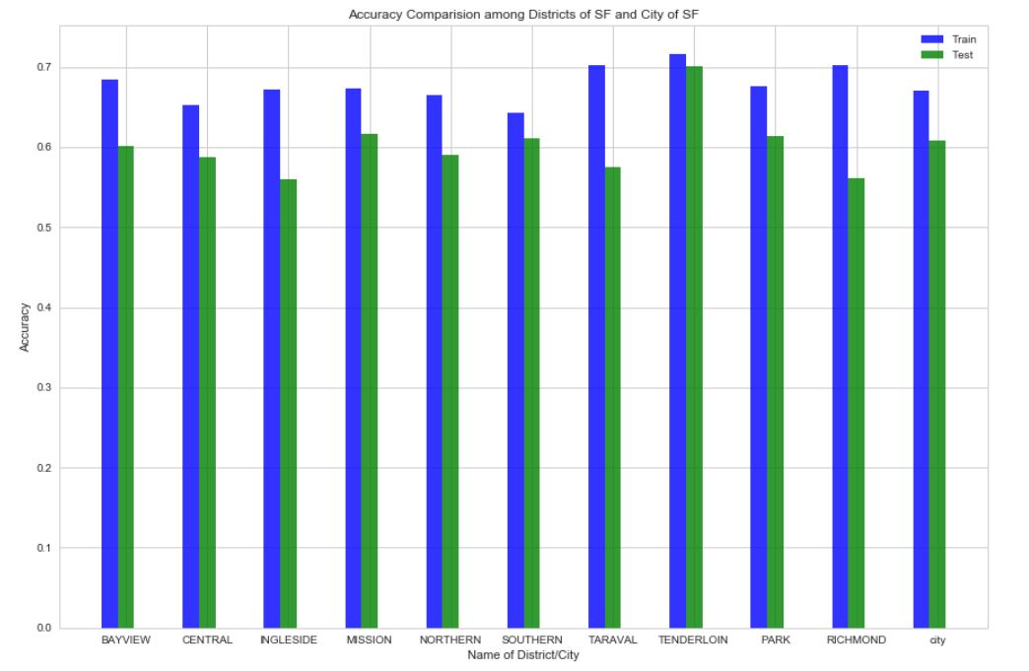
Multilayer Perceptron Classifier Results
Improved performance using domain knowledge
Models ‘Simple MLP’, ‘MLP with K fold’ and ‘MLP with K fold and TruncatedSVD’ exhibits nearly similar behaviour.
No major difference among City level model(last bar) and district level models.

Slide 6
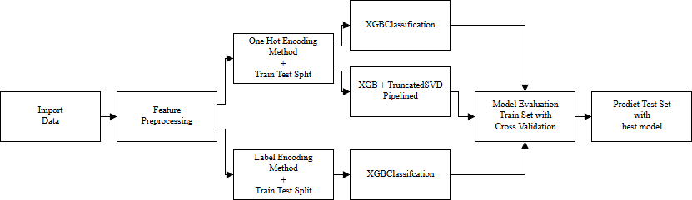
XGB Methodology/Architecture
3 modelling methods:
XGB on One Hot Encoded features (sparse binary columns)
XGB on Label Encoded features (singular ordinal column)
XGB w/ Truncated SVD dimension reduction on One Hot Encoded features
Tune hyperparameters using RandomizedSearchCV and StratifiedKFold

Slide 7
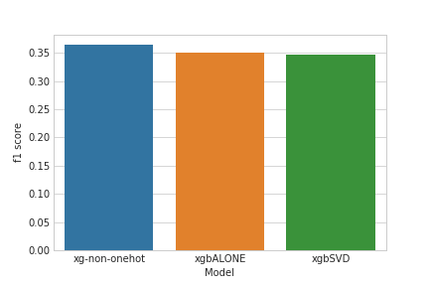
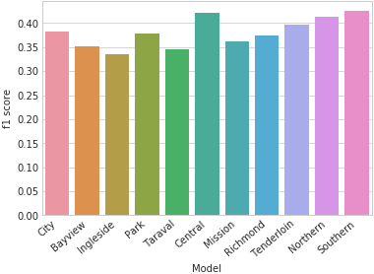
Extreme Gradient Boosting (XGB) Results
3 Methods had extremely similar f1 scores
XGB on one-hot-encoded marginally faster
Applied to all districts and whole city
F1 scores similar throughout different districts/city
Low scoring/results, attributed to lack of relevant/important features to properly categorize into 39 different label possibilities.

Slide 8
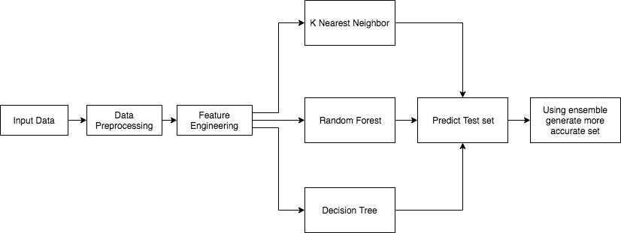
Ensemble
Ensembling of following Classification Models:
K Nearest Neighbor
Decision Tree
Random Forest

Slide 9
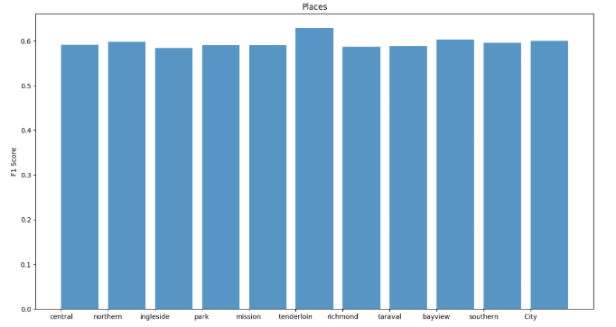
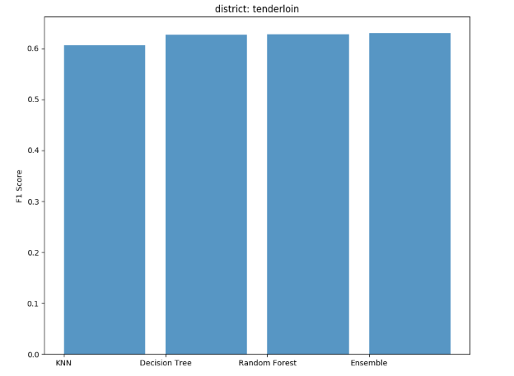
Ensemble
All 3 algorithms provides almost equivalent F1 Score
Improvement in performance by further categorizing 39 type of crimes into Index (Severe) and Non-Index Crime (Less Severe)
Ensembling algorithms provides nearly better accuracy

